Slide 1
“Code Troopers” Sprint 1 Stakeholder Update
February 8th, 2022

Slide 2


Introducing the Geopop Browser
Free
Focused on UX
Search protection
Multi-function

Slide 3

Fundamental Features/Requirements
Dynamic Geographical Report Generation
Total population of Geographical area Statistics
Total speakers of Geographical area Statistics
Docker Deployed Software (Page 6)
Simple and accessible UI
Full and accurate Data

Slide 4

Expanded Features
Account Creation
Help Line
Support Data Input
Software settings
Automated Data Updating

Slide 5
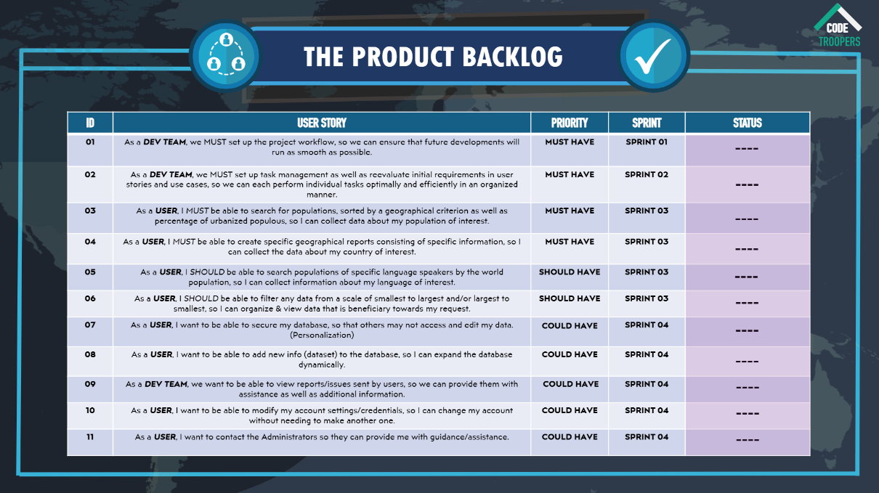

Slide 6
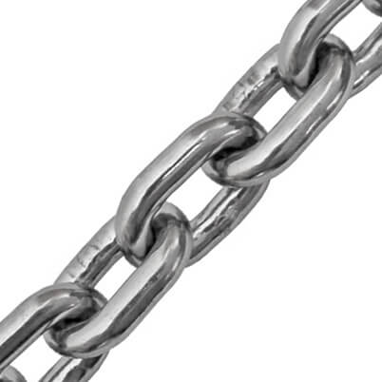
Code of Conduct
Behaviour
Organization
Integrity

Slide 7

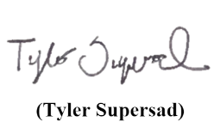
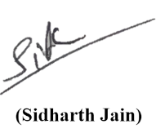

Code of Conduct
Behaviour
Organization
Integrity

Slide 8

Docker
Deployment
Implementation
Benefit

Slide 9

First Release Additional Content
Meetings log for Stakeholders
Proof of Concept materials
Persona
Meet the team HTML page

Slide 10


Slides prepared by Code Troopers
Add your
Software Engineers at Kamino Softworks who work to change the world and improve the lives of people around the globe. Graduates from Roehampton in 2023 with a degrees in Computer Science. Love to work improving the future with a diverse and dedicated staff.
Code Troopers make no claim to ownership of Media images in this powerpoint. Images taken from Google.

